Slide 1
Acquire & Organize
Analyze
Deliver
Data Source
Data Integration
Data Gathering
Data Storage
Data / Exploration
Visualization
Modeling
Deploy
ERP
Warehousing
Environment
Statistics
Prescriptive Analytics
Recommendation Systems
Model Monitoring
Batch Data Integration
Time series
Predictive Analytics
Interface
CRM
Structured
Segmentation
NOSQL Environment
Reports
DS/ML Platforms
Simulation
and Optimization
Version Control
Databases
Stream Ingestion Real time
Semi- and Un-Structured
Machine Learning
Speech Analytics
Dashboard
Orchestration
Big Data/Distributed Environment
Deep Learning
Video/Image Analytics
External Sources
Streaming
Security
Text Analytics
Message Broker
Graph Analytics
Sentimental/ Behavioral Analytics
Containerization
Real time Reporting
Files
Cloud
Environment
Geospatial and
Location Analytics
Could Platforms

Slide 2









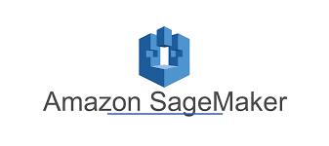






















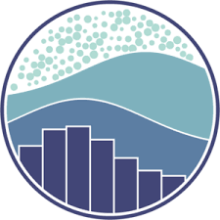







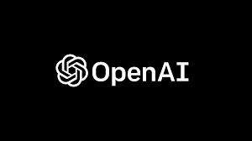



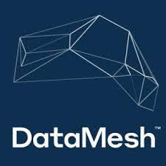
















Technologies Infomineo can be handling
Web design/
Webscrapping ?
Model Monitoring & Version Control
Statistics
DS/ML Platforms
Integration
Cloud Platforms
Oryx
Containerization
Data Robot
VertexAI
Interface
Machine Learning
Visualization
Seaborn
Cloud
Orchestration
Big Data/
Distributed
NOSQL
Warehousing

Slide 3
ML tools | Statistics
Scikit -learn | Pandas
Tensorflow | Numpy
Huggingface Transformers | Statsmodels
pytorch | Matlab
OpenAI | Scipy
Data Science
Python, SAS, R
AI
ML
Advanced Analytics
Computer Vision
ou mettre les langages
Scala
PySpark
Hive
Impala
Pig
R ??
Julia | Shiny
seems to be a langage | websites
ML Skills
NLP | Computer Vision | Advanced Analytics | General | Generative AI ?
NLTK | Object Detection | Time Series | Scikit -learn
LLM | Image Generation | Predictive Analytics | Tensorflow
Fuzzy Matching | Video/Image Classification | Recommendation systems | Huggingface Transformers
ElasticSearch | OCR | Clustering | pytorch
Conversational Bot | Anomaly detection | Geospatial data | OpenAI
sentiment analysis
Summarization |  |  | ONNX?
Speech2text

Slide 4
Visualisation | Data Gathering/Data bases/Querry | Big Data & Distributed Environnement | End to end frameworks | Could Ecosystems/Cloud Computing | Interface | real time island | MLOps
Power BI | SQL | Kubertnetes | AWS SageMaker | GCP | Gradio | Spark streaming | mlflow
D3.js | Google Big Query | Docker | Dataiku | AWS | Streamlit | Kafka | kubeflow
Tableau | NOSQL | Hadoop | Alteryx | IBM Cloud | Flask | Oryx | tfserving
Looker | Snowflake | Spark | AutoML |  | Django |  | Airflow
Seaborn | DataMesh |  | Vertex AI |  | React native |  | Prefect
matplotlib | ElasticSearch |  |  |  |  |  | kubeflow
Google API
boilersoup
octoparse
Twitter API

Slide 5














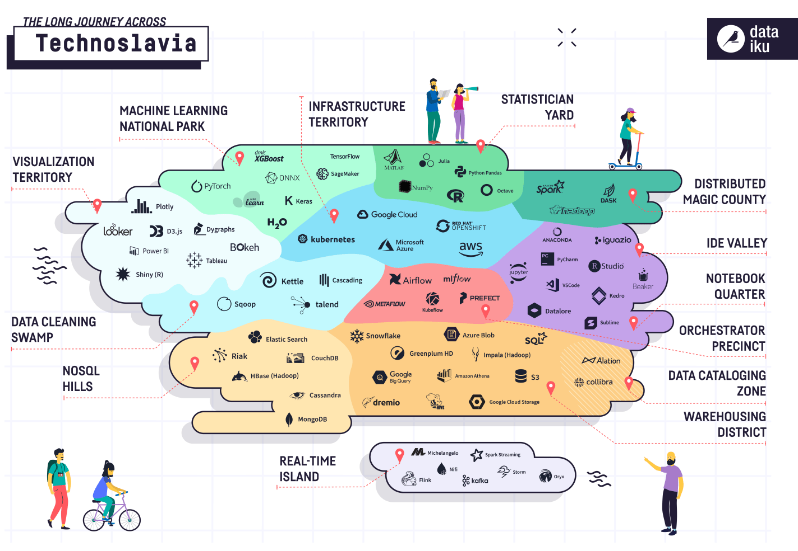
















Technologies Infomineo can be handling
Statistician yard
Distributed magic county
Machine learning National Park
Ide Valley
Infrastructure territory
Notebook quarter
Capabilities we already have
Visualization territory
Capabilities we are building
Orchestrator precinct
Big Data/
Distributed
NOSQL
Warehousing
Real-time island

